Slide 1
A Experiência do Projeto SICONFI
II Seminário Brasileiro de Contabilidade Aplicada ao Setor Público – SBCASP
Gianluca Garbellotto
Brasília, 19 de Maio de 2014

Slide 2
Agenda
Introdução ao XBRL e XBRL Global Ledger
Introdução (rápida) ao Projeto SICONFI - Mais depois
O DATA Act em os EUA

Slide 3
Introdução ao XBRL e XBRL Global Ledger

Slide 4
O Valor dos Padrões
It's About Agreement!
It's about (sufficient)
understanding.
Standardize on
STANDARDS
Not TECHNOLOGY

Slide 5
Combine a Infra-Estrutura com o Padrão Correspondente
RJ 11
40’ x 8.5’ x 8’
UPC
HTML / SOAP / Web Services
4’ 8.5”
RJ 45
Rosettanet, MDDL, XBRL
220V, 50Hz
Rail Road
Electricity
Telephone
Shipping
Product
Networking
Internet
Information
XBRL
Business data transparency

Slide 6
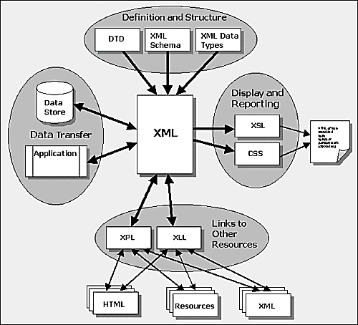
XML Family
XML
Rules for text and angle brackets
XML Schema
Validation tool for XML
Namespaces
Same words, different schemas
XLink
Ties XML to internal and external references
XSL and CSS
XML with “Style”

Slide 7
XML Without Agreement …
XML is “self-defining?”
Sure, this looks simple:

Slide 8
… is just SYNTAX
But how “self-defining” is this?
To a computer (XML parser), they are the same
The tags (element names) provide no semantic knowledge to the program

Slide 9
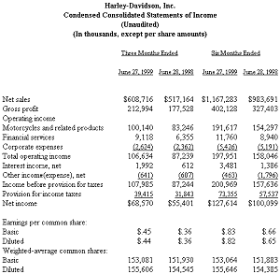
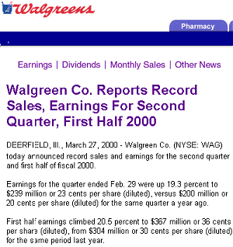
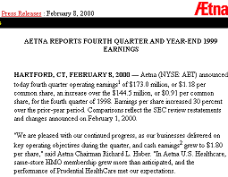
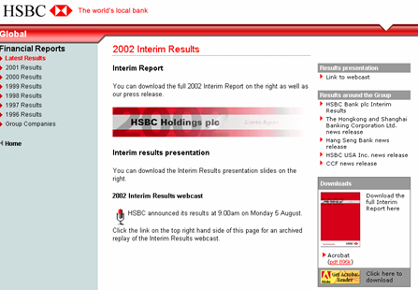
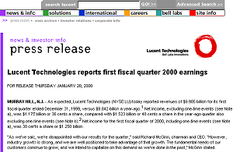
Catalyst: Standardizing Business Reporting
Today over 65,000 International public companies release financial results half yearly and quarterly…
But the contents are not organized. The data must be reentered into computer applications for interpretation.
What if financial documents included both content (€75,453) and structure (€75,453=net income for Q1/2011)?
ENTER XBRL

Slide 10
Catalyst: Standardize Management Reporting
Transactional data
Multiple departmental Excel spreadsheets
Consolidated spreadsheets for management
System A
SQL
Senior Management
System B
SQL
System C
2000 elements
=
6500 spreadsheets (this is not a typo)

Slide 11
Some “Problems” with Today’s Model
Information goes in one direction
Information has no shared context
Analysis of the information is conducted via macros that are embedded within the applications and are not reusable by others …….
Information labels are inconsistent from one application to another
Information is not independently validated
Information is not connected to other related resources across applications
Information Is
Application-Dependent

Slide 12
XBRL: Three Primary Components
Community
Accounting profession, developers, regulators, users,
financial services, data aggregators … 800+
Multi-dimensional
Optimized for business reporting
Discoverable
Reusable information
Extensible
More detail
Shared understanding
XML describes, XBRL defines
Specification
Syntax and semantics
of taxonomies and instances
XML, Namespaces, XML Schema, XLink
US GAAP, IFRS, XBRL GL, SBR
and others…
Taxonomies

Slide 13
Where is it relevant? – The BRSC
Accounting
Software
ERP systems
UBL
Rosettanet
ACORD
MISMO
FPML
Others
SCOA/Trial balance
AP/AR Ledgers
General Ledger
Fixed Assets, Inventory
Documents/Entries
Parties, entities
KPIs – financial and not
Others
US GAAP
IFRS
SBR
GRI G3
Statutory
MD&A
Transaction
Layer
XBRL Global
Ledger
XBRL External Reporting
Business
Operations
Internal
Business
Reporting
External
Business
Reporting
Investment,
Lending,
Regulation
Economic Policymaking
Processes
Crating the seamless interface

Slide 14
How Is It Used?
Transparency and greater analytical insight and capabilities – SEC in the US and similar global regulatory programs
Reduction of the reporting burden for businesses – SBR programs
Efficient collection and dissemination of government information – SICONFI in Brazil, Open Government initiatives, such as the DATA Act in the US
Automation, efficiency and cost reduction in data related corporate processes

Slide 15
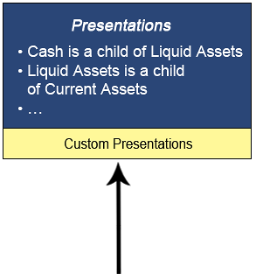
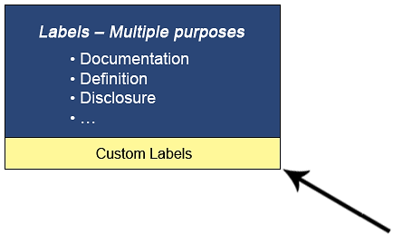
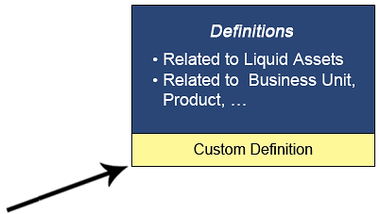
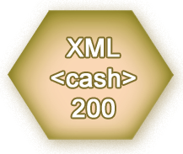
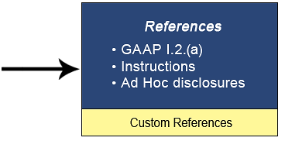
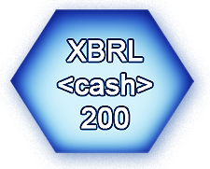
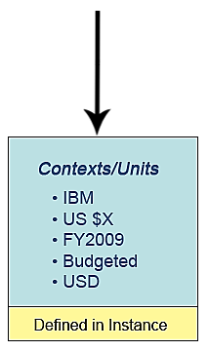
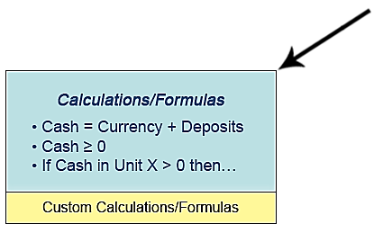
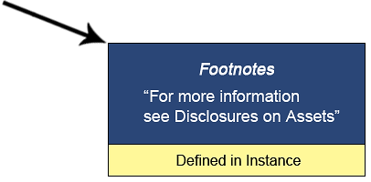
XBRL is More Than Just Tagging Business Information
Multi-dimensional business and financial data representations
Flexibility of business reporting vocabularies (i.e. taxonomies)
Mathematical relationships between concepts
Flexibility about how to present information to users

Slide 16
XBRL FR and XBRL GL
XBRL for Financial Reporting (XBRL FR) or, more generally, XBRL for End Reporting (XBRL ER)
Represents summarized reports
“Loose” data model composed by data points (fields in reports) linked by arcs (linkbases) and referencing context and units information defined in separate XML fragments within the XBRL instance document
XBRL Global Ledger (XBRL GL)
Represents detailed, “transactional” data and its mappings to data points in XBRL FR taxonomies
Structured data model (XML Schema) similar to structure of information stored in accounting/ERP software
Easy to map to
Enables greater control on data quality in end reports

Slide 17
The Standards-Driven Paradigm Shift
No need to replace or modify existing systems
Software tools, lessons learned, business processes and knowledge bases are reusable in different projects and domains
Application-independent data accuracy and consistency and process automation
Data transparency
Minimally invasive, low cost technology

Slide 18
Projeto SICONFI

Slide 19
How XBRL Is Used in SICONFI
Source/Detailed Data
Mappings
Summarized Reports
XBRL GL
XBRL GL
XBRL FR
DCASP
MSC
RGF
COC
(Operations)
RREO
DEFP
Outros
PCASP
COC
(Reports)

Slide 20
How XBRL Is Used in SICONFI
Standard Business Reporting (SBR) Taxonomy Architecture
Definitional Taxonomy – Common Dictionary
Define the concept once…
Information
Classification A
Information
Classification B
…
A.1
B.1
A.2
B.2
Address
Wages & Salaries
… re-use on many reports
Reporting Taxonomies
Agency X
Agency Y
Agency …
Report X.1
Report Y.1
Report X.2
Report Y.2

Slide 21
The Digital Accountability and Transparency Act (DATA) in the USA

Slide 22
Overview
It’s all about open data
The transformation: Government-wide data standards; comprehensive publication requirements
The scope: Federal financial, assistance, procurement, and performance reporting
The driver: Legislative mandate
Notes:
Better performance starts with open data.
The U.S. government is embarking on an ambitious transformation of all financial, assistance, procurement, and performance reporting from document-based reports to transparent--standardized according to government-wide guidance and available to the public and Congress as well as to business managers.

Slide 23
Current Landscape
Financial reporting: Agencies to Treasury
Payment requests: Agencies to Treasury
Budget planning and actions: Agencies to OMB
Assistance: Agencies to Commerce, GSA
Procurement: Agencies to GSA
Grants: Awardees to agencies
Contracts: Awardees to agencies, GSA
Subawards: Prime awardees to OMB
GPRA: Agencies to Congress, OMB

Slide 24
Current Shortcomings
Information not available. The public, Congress, Treasury and OMB, agency leaders, inspectors general, and even program managers don’t have the data they need.
Information not accessible. Information is frequently available only as documents or summaries.
Information not interoperable. Government-wide data fields, even for basic concepts, don’t exist. Formats differ. There is no way to link spending and performance.

Slide 25
DATA: the Basics
Treasury and OMB
Establish government-wide identifiers
Establish government-wide formats
Publish grants, contracts, and internal spending on existing USASpending.gov portal
Pilot program for consolidated reporting by grantees and contractors
Agencies
Apply the standards wherever applicable
Data quality checks
Awardees
Standardized reporting imposed by agencies
Recovery Board
Accountability platform to Treasury

Slide 26
DATA: Desired Impact
Public Accountability. Citizens have access to accurate, complete, searchable data on government spending and performance
Better Management. Congress, Treasury, OMB, agency leaders, inspectors general, program managers utilize dashboards and analytics
Automated Compliance. Grantees and contractors report to agencies without strain; agencies automate reports to Treasury, OMB, Commerce, GSA, Congress

Slide 27
Implementation
Treasury and OMB to issue guidance 1 year after passage
Agencies to begin using data standards 2 years later
Grant/contract reporting consolidation pilot starts 1 year after passage and lasts 2 years

Slide 28
Project SICONFI Helped…
Significant XBRL implementation in the G2G space in a major economy
Government SCOA used in both countries
Use of XBRL GL in conjunction with XBRL reports to
Simplify implementation for Government entities
Enhance data quality through pre-defined mappings and the ability to “push” validation rules at the USSGL (MSC) and transactional level
SBR taxonomy architecture

Slide 29
OBRIGADO!
Your Speaker:
Gianluca Garbellotto
IPHIX, CEO
XBRL Best Practices Board, member
XBRL Global Ledger Working Group, Chair
gg@iphix.net
Twitter: @iphixbrl

